Slide 1
AHSANULLAH UNIVERSITY OF SCIENCE AND TECHNOLOGY
DEPARTMENT OF COMPUTER SCIENCE AND ENGINEERING
SUBMITTED BY : SANJANA AKHTER
ID NO : 20210104150
SECTION : C2

Slide 2
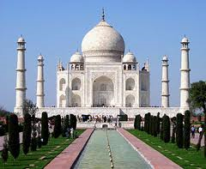
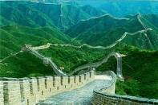
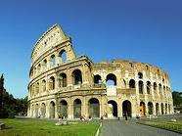
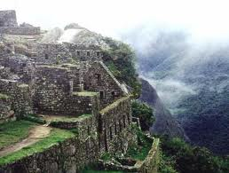
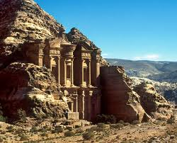
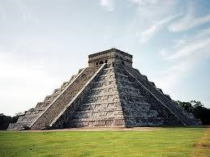
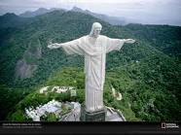
7
WONDERS
O f t h e w o r l d……

Slide 3
7 Wonders of Modern World
This list of wonders were announced by “New7Wonders Foundation” in Portugal on July-7-2007
Taj Mahal (India)
Great Wall of China (China)
Colosseum (Italy)
Machu Picchu (Peru)
Petra (Jordan)
Chichen Itza (Mexico)
Christ the Redeemer (Brazil)

Slide 4
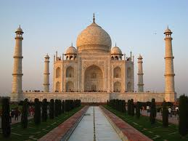
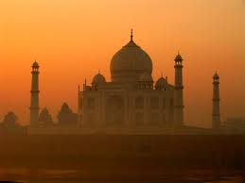
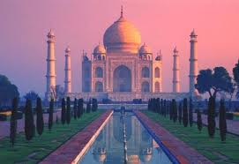
1.Taj Mahal
(Agra, India)
Built by Muslim Mughal Emperor “Shah Jahan”
Memorial for his beloved late wife, “Mumtaz”
Took 15 years
Finest example of Mughal Art
Arrested by one of his son
It said that he spent the rest of the days gazing at Taj Mahal from a window.

Slide 5
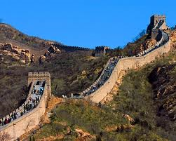
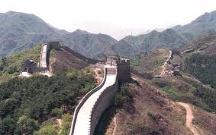
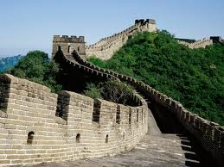
2.Great Wall of China
(China)
Was built along China’s northern border over many centuries
To keep out Mongol tribes
Constructed between 5th century – 16th century BC
Largest human made structure.
4000 miles

Slide 6
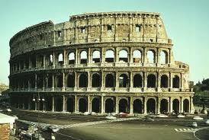
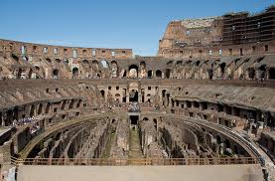
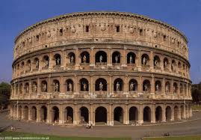
3.Colosseum
(Italy)
Constructions began under Empire Vespasian
Sports stadium
50,000 spectators
Gory games involving gladiators, wild animals and prisoners were held there in ancient time
Modern Stadium

Slide 7
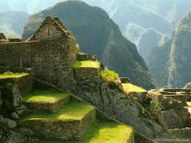
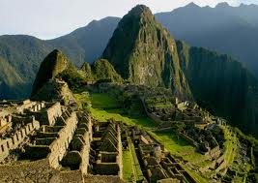
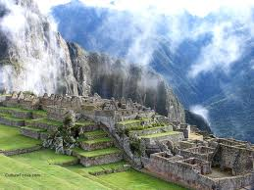
4.Machu Picchu
(Peru)
It is a 15th Century mountain settlement in the Amazon region of Peru
Ruined city Inca civilization
West South America

Slide 8
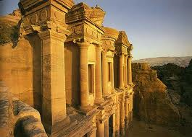
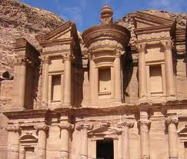
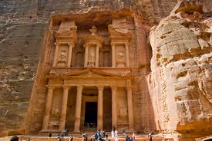
5.Petra
(Jordan)
Perched on the age of the Arabian dessert
Capital of Nabatocan kingdom
stone structure
Classical shapes
Coloured rocks

Slide 9
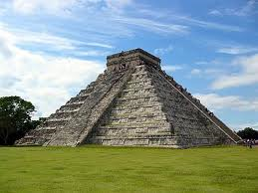
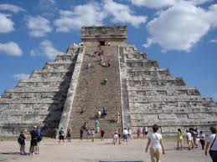
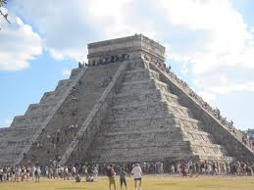
6.Chichen Itza
(Mexico)
This is the most famous temple city of “Maya’s”
Political & religious centre
Known as a temple
City’s heart
Rises to a height of 79 feet.
91 steps in each of its four sides
365th Day of the year represents the top platform.

Slide 10
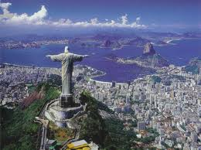
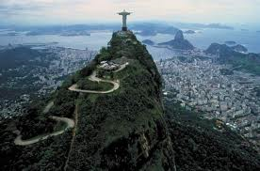

7.Christ the Redeemer
(Brazil)
It is in the Rio-De Janerio, Brazil
130 Feet tall
Second highest statue
Symbol of Christianity
An icon of Rio & Brazil
Made of soapstone

Slide 11
7
WONDERS
O f t h e w o r l d
-Thank You
ANY QUESTION?

